Slide 1

AMAZON Web Services

Slide 2
Agenda
What is AWS?
What is cloud computing and types of clouds
Benefits and applications of AWS
Frequently used tools in AWS
IAM and various security policies
EC2 demonstration
VPC and its demonstration
S3 bucket demonstration
Amazon RDS introduction and demonstration

Slide 3
Introduction to AWS
Amazon Web Services – Cloud Computing
What is Cloud Computing?
Cloud computing is an internet-based computing service in which large groups of remote servers are networked to allow centralized data storage, and online access to computer services or resources.
Using cloud computing, organizations can use shared computing and storage resources rather than building, operating, and improving infrastructure on their own.
Cloud computing is a model that enables the following features.
• Users can provision and release resources on-demand.
• Resources can be scaled up or down automatically, depending on the load.
• Resources are accessible over a network with proper security.
• Cloud service providers can enable a pay-as-you-go model.

Slide 4
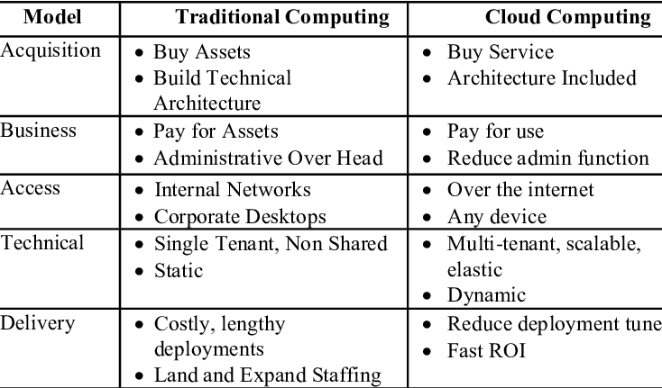
Traditional computing vs. Cloud computing

Slide 5
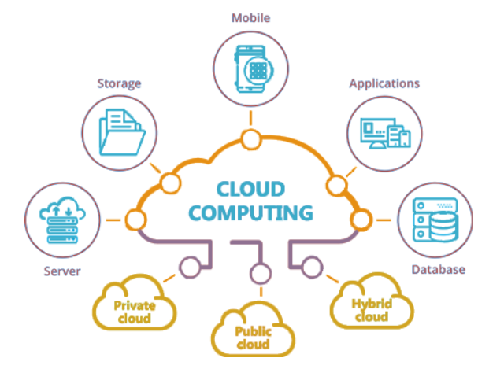

Slide 6
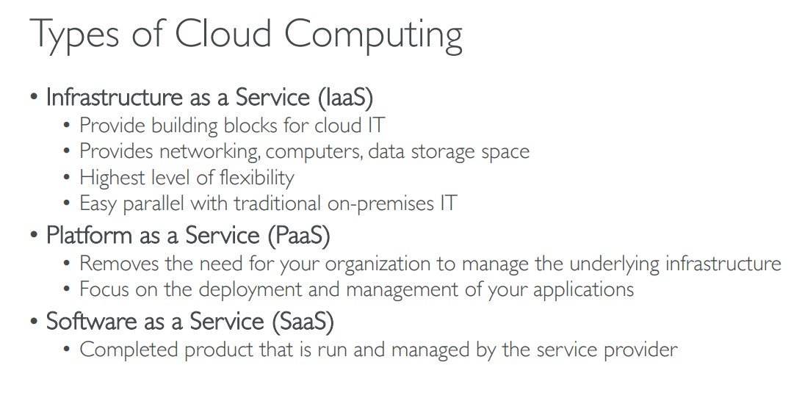

Slide 7
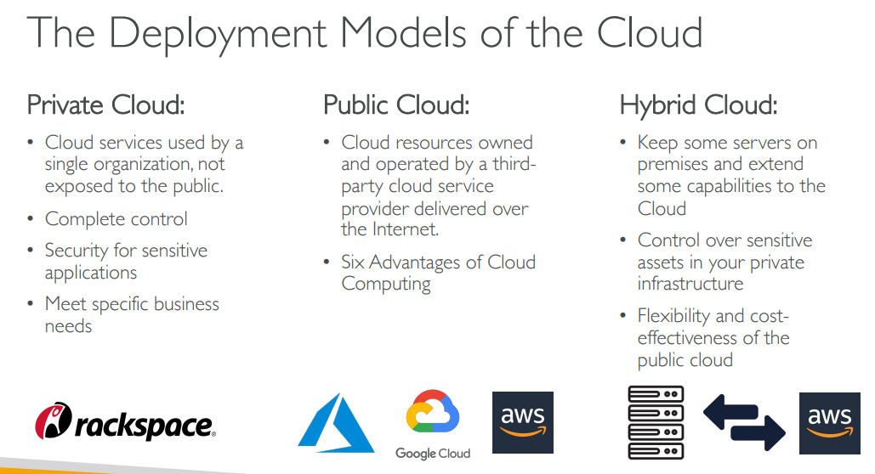

Slide 8
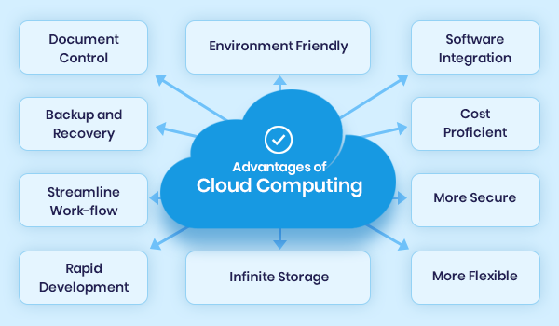

Slide 9

AWS - Amazon Web Services
Definition of AWS
Amazon Web Services(AWS) is a cloud service from Amazon, which provides services in the form of building blocks, these building blocks can be used to create and deploy any type of application in the cloud.

Slide 10
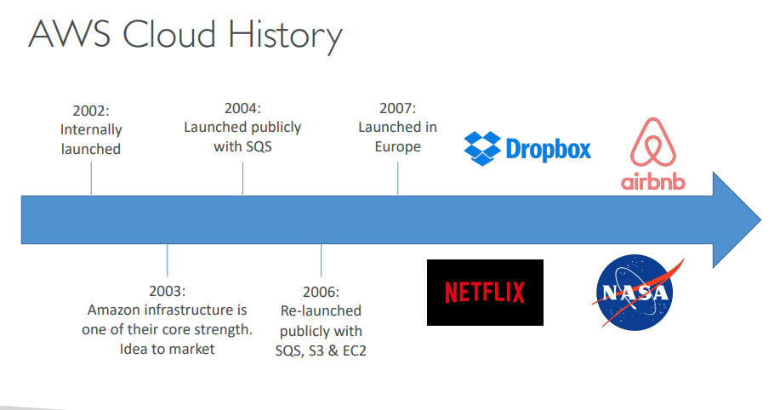

Slide 11
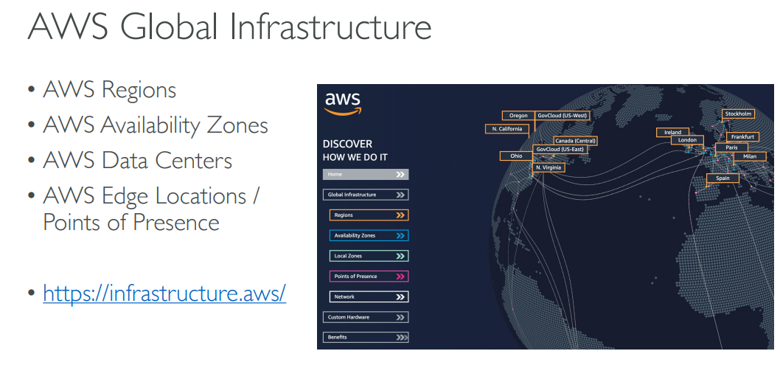

Slide 12
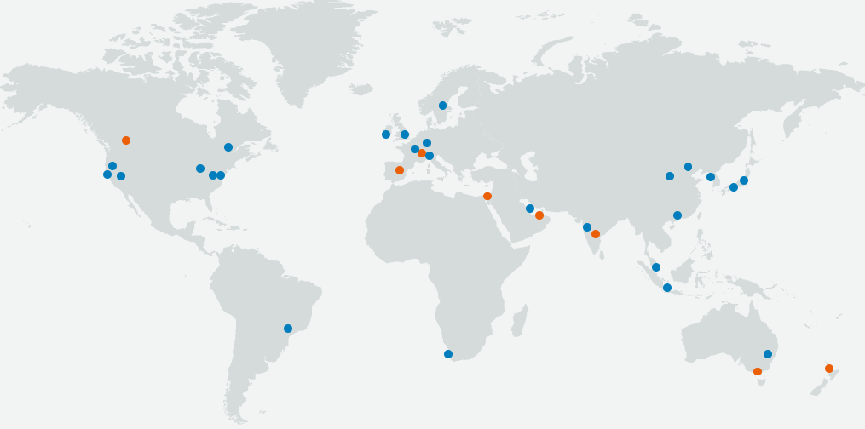
Global Network of AWS Regions

Slide 13
Services offered by the AWS
AWS offers us a wide variety of services depending on our business needs. Some of the most frequently used services by the IT industry are as follows.
1. Compute Services → Amazon EC2, AWS Lambda Functions, Amazon Lightsail, etc.
2. Storage Services → Amazon S3, Amazon EBS, Amazon EFS, Amazon S3 Glacier, etc.
3. Databases → Amazon Aurora, Aurora DynamoDB, Amazon RDS, Amazon Redshift, etc.
4. Security
5. Networking Services

Slide 14
AWS Lambda
Lambda is a compute service that lets you run code without managing servers.
Lambda runs your code on a high-availability compute infrastructure and performs all of the administration of the compute resources, including server and operating system maintenance, capacity provisioning and automatic scaling, code monitoring, and logging.
With Lambda, you can run code for virtually any type of application or backend service.
All you need to do is supply your code in one of the languages that lambda supports.
When to use Lambda?
Lambda is an ideal compute service for many application scenarios, as long as you can run your application code using the Lambda standard runtime environment and within the resources that Lambda provides.
When using Lambda, you are responsible only for your code.
Lambda manages the compute fleet that offers a balance of memory, CPU, network, and other resources to run your code.

Slide 15
Amazon RDS (Relational Database Service)
Amazon Relational Database Service (Amazon RDS) is a web service that makes it easier to set up, operate, and scale(estimate) a relational database in the AWS Cloud. It provides cost-efficient, resizable capacity for an industry-standard relational database and manages common database administration tasks.
Advantages of Amazon RDS
You can use the database products you are already familiar with: MySQL, MariaDB, PostgreSQL, Oracle, and Microsoft SQL Server.
Amazon RDS manages backups, software patching, automatic failure detection, and recovery.
You can turn on automated backups, or manually create your own backup snapshots. You can use these backups to restore a database. The Amazon RDS restore process works reliably and efficiently.
What is a DB instance?
A DB instance is an isolated database environment in the AWS Cloud. The basic building block of Amazon RDS is the DB instance.

Slide 16
DB engines
A DB engine is the specific relational database software that runs on your DB instance. Amazon RDS currently supports the following engines:
MySQL
MariaDB
PostgreSQL
Oracle
Microsoft SQL Server
Each DB engine has its own supported features, and each version of a DB engine may include specific features.
Monitoring an Amazon RDS DB instance
There are several ways that you can track the performance and health of a DB instance. You can use the Amazon CloudWatch service to monitor the performance and health of a DB instance. CloudWatch performance charts are shown in the Amazon RDS console.

Slide 17
AWS Software Development Toolkit (SDK)
The AWS Cloud Development Kit (AWS CDK) is an open-source software development framework to define your cloud application resources using familiar programming languages.
AWS CDK uses the familiarity and expressive power of programming languages for modeling your applications.
It provides high-level components called constructs that preconfigure cloud resources with proven defaults, so you can build cloud applications with ease.
Benefits of SDK
Easier cloud onboarding
CDK allows you to use your existing skills and tools, applying them to the task of building cloud infrastructure. It also provides high-level components that preconfigure cloud resources with proven defaults, helping you build on AWS without needing to be an expert.
Faster development process
AWS CDK gives you the expressive power of programming languages for defining infrastructure. Familiar features such as objects, loops, and conditions accelerate your development process.

Slide 18
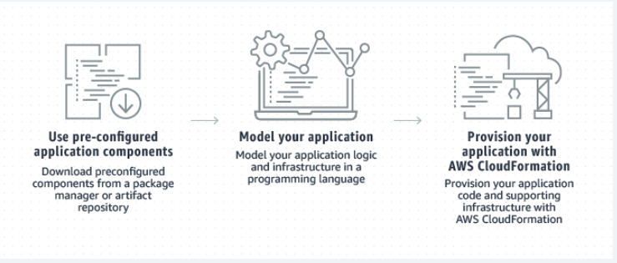
Customizable and Sharing
You can design your own reusable components that meet your organization’s security, compliance, and governance requirements. As with any other software library, you can easily share components around your organization, enabling you to rapidly bootstrap new projects with best practices by default.
Working of SDK

